Slide 1
Bird App
By binaryBirds - Dec 6, 2024
Mauricio Audirac-Martinez
Prashant Ghimire
Dana Monzer

Slide 2
Purpose of Tool
Ever thought about having a relaxing break after a long day of work?
Use BirdApp to find the shortest route to cool birds
How about going bird watching?

Slide 3
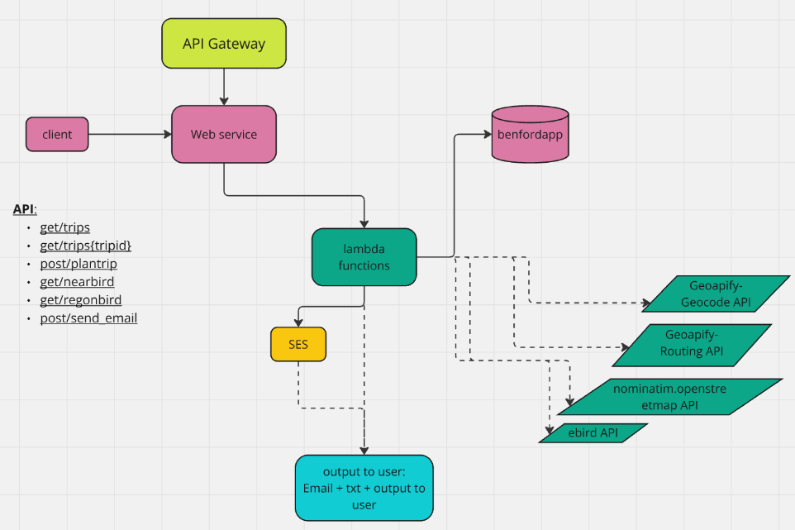
API Architecture

Slide 4
AWS Integration
We used the following components in AWS:
Lambda Functions
API Gateway
RDS
SES
Why did we use lambda functions?
Cheaper
Simpler to implement
Our code relies on python only so we used lambda layers only
Automatic Scaling
Computation time is <15 min
We do not need too much storage
Cold starts are not an issue for our project

Slide 5
Security & User Roles
Added new role with a specific permission policy for SES func.
Used existing project 3 roles & permission policies for other operations & read-writes
Webservice API keys secured in lambda

Slide 6
Server-Side
The architecture is serverless
Our tools is built on 5 lambda functions:
Trip planner (/plantrip POST):
Interacts with our RDS to save data
Interacts with Geoapify- Geocode API
Interacts with Geoapify- Routing API
Download Trip (/trips{tripid} GET):
Interacts with our RDS to extract data and report to user
Past Trips (/trips GET):
Interacts with our RDS to extract data and report to user
Nearby Birds(/nearbird GET):
Interacts with nominatim.openstreetmap API
Interacts with ebird API
Reports to user
Region Birds(/regionbird GET):
Interacts with ebird API
Reports to user
Send_email (/send_email POST)
Gets recipient’s email address and trip details from Client.
Sends user email with Trip details.

Slide 7
Client-Side
The client has the option to choose from different functions:
Show past trip request by all previous users + Send email with a selected trip details and instructions
Plan trip to the location of interest for bird watching, by different modes
Download trip details and instructions
See nearby birds within 50 km radius from your address
See birds in region of your request

Slide 8
Demo
We will show you next how the client can use our app!

Slide 9
Verify your Email
Send an email to prashantghimire2026@u.northwestern.edu

